Slide 1
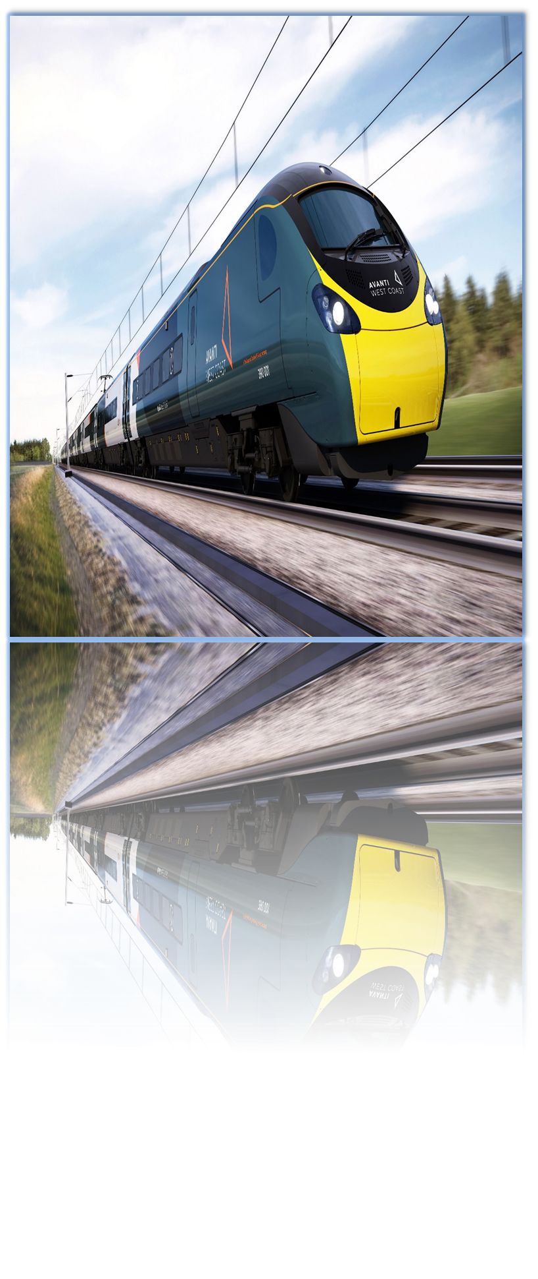



Timmerman Industries
UK TRAIN RIDES
DATA ANALYSIS
DATE:12/4/2025
Project Team :
1.Aya Ahmed Abdelfattah
2.George Gerges Georgy
3.Omnya mamdouh Ibrahim
4.Esraa Ahmed Abou ElQassem
START

Slide 2




Overview
This project aims to analyze train journey data in the United Kingdom (National Rail) for the period from January to April 2024. The dataset includes information on departure and arrival stations, ticket prices, journey times, and ticket categories. The goal is to derive important insights that help understand passenger behavior and improve services and operations.

Slide 3
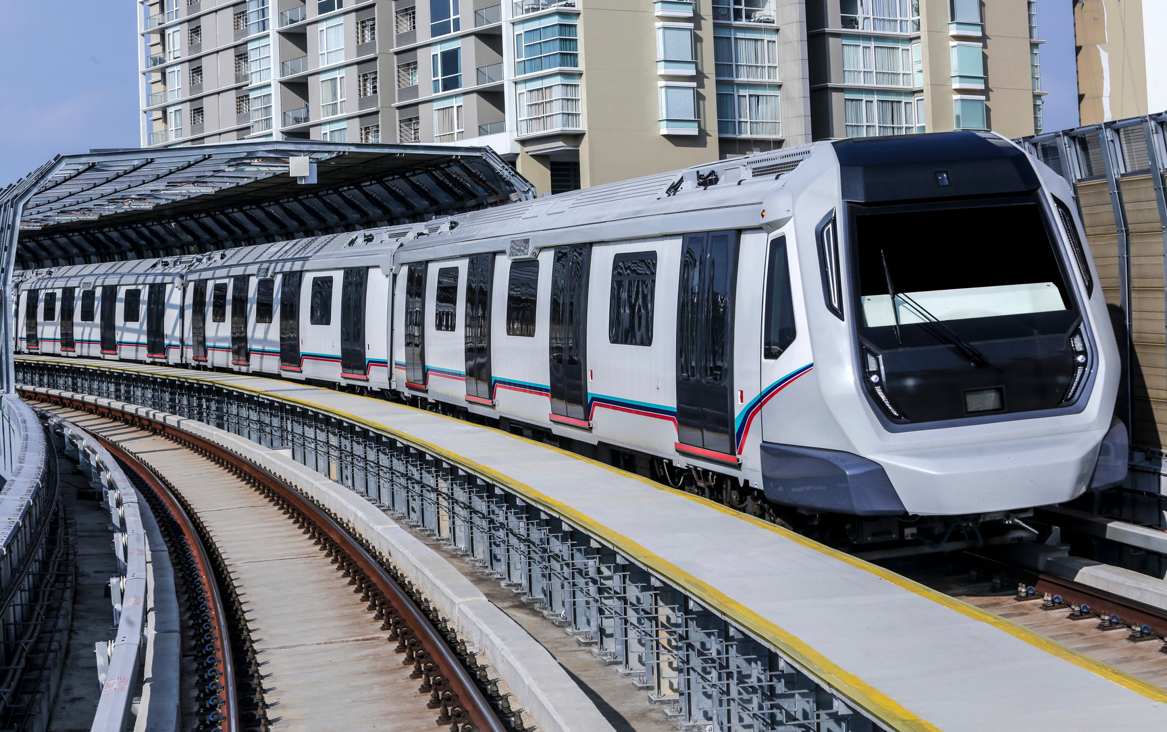

Objectives
Identify the most popular routes: Determine which stations and lines have the highest passenger density.
Analyze revenue by ticket type: Understand how income is distributed across various ticket types and classes.
Forecast demand trends: Use predictive models to estimate future demand for train journeys.

Slide 4
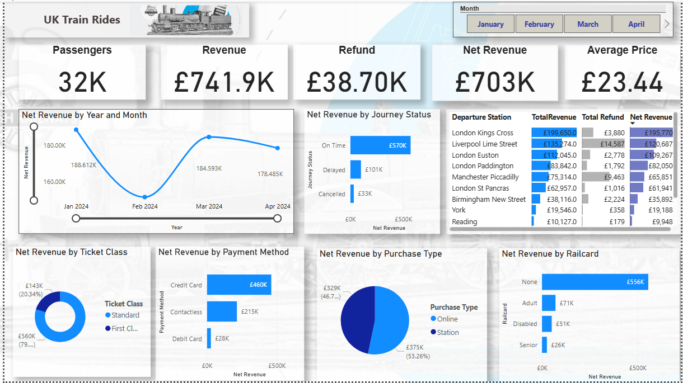

Slide 5


Financial Performance Overview
Category | Value
Total Passengers | 32,000
Gross Revenue | £741.9K
Net Revenue | £703K
Refunds Issued | £38.7K (5.2%)
Average Ticket Price | £23.44
Peaks: January (£188.61K), March (£184.59K).
Declines: February (£168.61K), April (£178.48K).
Recommendation: Investigate seasonal factors (e.g., holidays) and launch promotions during low-demand months.

Slide 6
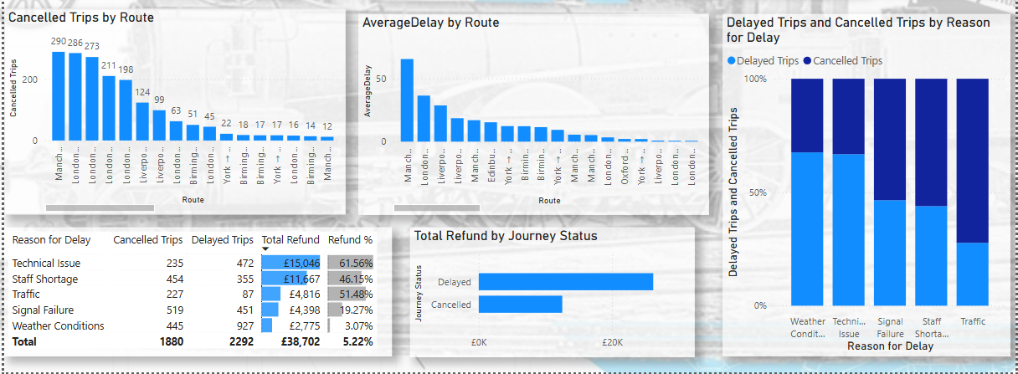

Slide 7
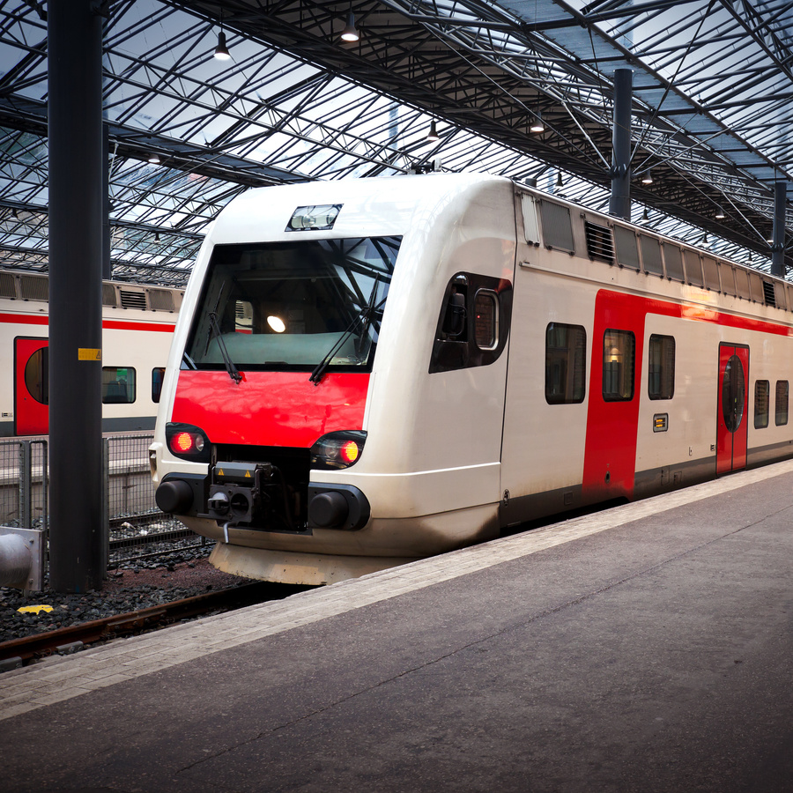


Operational Performance
Average Delay by Route:
Again, Manchester – London has the highest average delay, more than 50 minutes!
Other routes like London – Birmingham and Liverpool – Manchester also have big delays.
Most other routes have short delays.
Cancelled Trips by Route:
The most cancelled route is Manchester – London with 290 cancelled trips.
Then comes London – Birmingham (286) and London – Manchester (273).
Other routes have much fewer cancellations.

Slide 8



Reason | Cancelled | Delayed | Total Refund | Refund %
Technical Issue | 235 | 472 | £15,046 | 61.56%
Staff Shortage | 454 | 355 | £11,667 | 46.15%
Traffic | 227 | 446 | £4,816 | 51.48%
Signal Failure | 519 | 451 | £4,398 | 19.27%
Weather Conditions | 445 | 927 | £2,775 | 3.07%
Total | 1,880 | 2,292 | £38,702 | 5.22%
Refund Summary
Critical Issues
·The Manchester–Leeds route faced severe delays (65 mins average) due to signal failures.
Manchester–Liverpool route had 290 cancellations (traffic-related

Slide 9
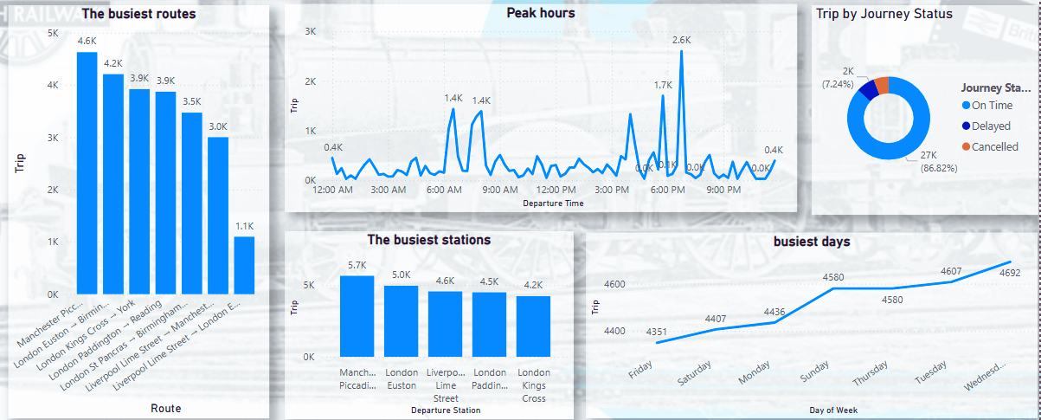

Slide 10


Busiest Network Hubs
·Routes: Manchester–Liverpool (4.6K trips), London Euston Manchester (3.9K trips).
·Stations: Manchester Piccadilly (5.7K trips), London Euston (5.2K trips).
·Peak Hours: 6:45 PM (2.6K trips).
Observation: Midweek demand (Tuesday–Friday) dominates, driven by commuter traffic.

Slide 11
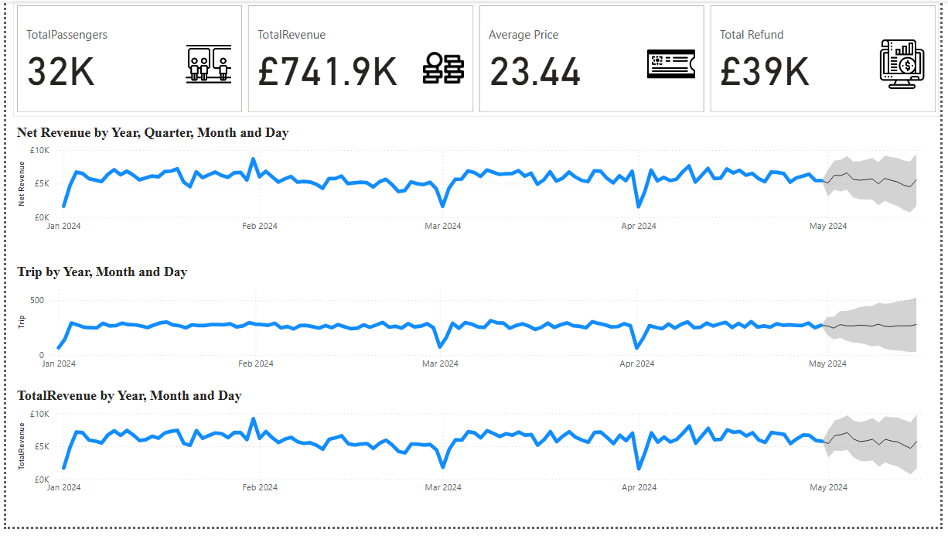

Slide 12
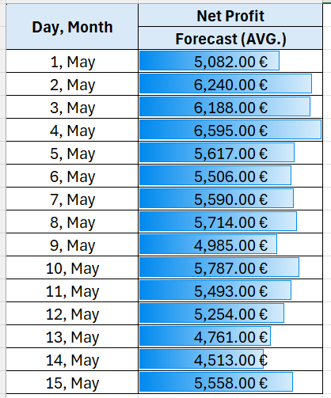
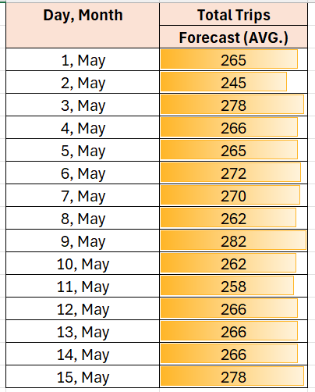
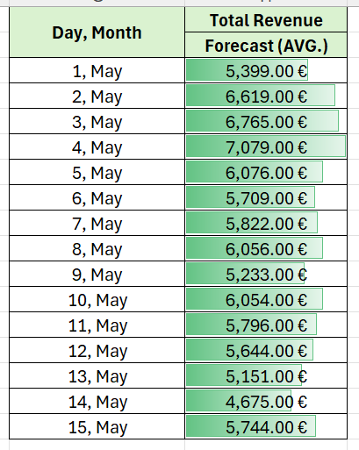
Forecasting summary for May 2024

Slide 13

Strategic Recommendations
Optimize Staffing : Address shortages during peak hours and extreme weather
Upgrade Infrastructure: Prioritize signal system upgrades on high-delay routes
Reduce Refunds: Mitigate technical failures and staff shortages
Boost High-Value Segments: Promote First Class perks and Rail card adoption
Expand Digital Channels : Increase online bookings (53% of sales) and contactless payments (30.6%).
Peak Hours: Add capacity during 6:00–8:00 PM.
Off-Peak Incentives: Offer discounts for travel on Sundays/Mondays.

Slide 14
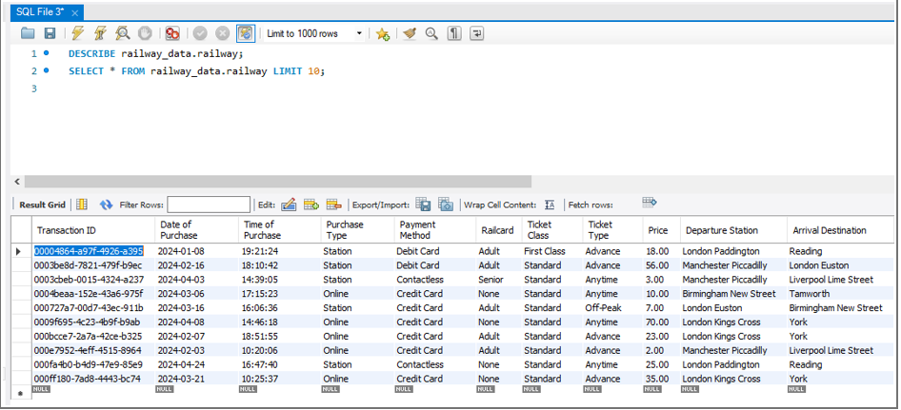
Data Model, Data Cleaning and Preprocessing by SQL

Slide 15
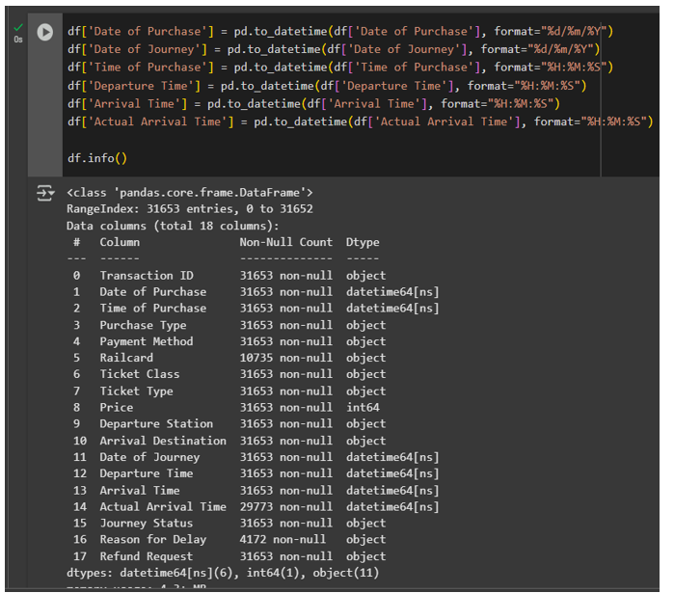
Data Model, Data Cleaning and Preprocessing by Python

Slide 16


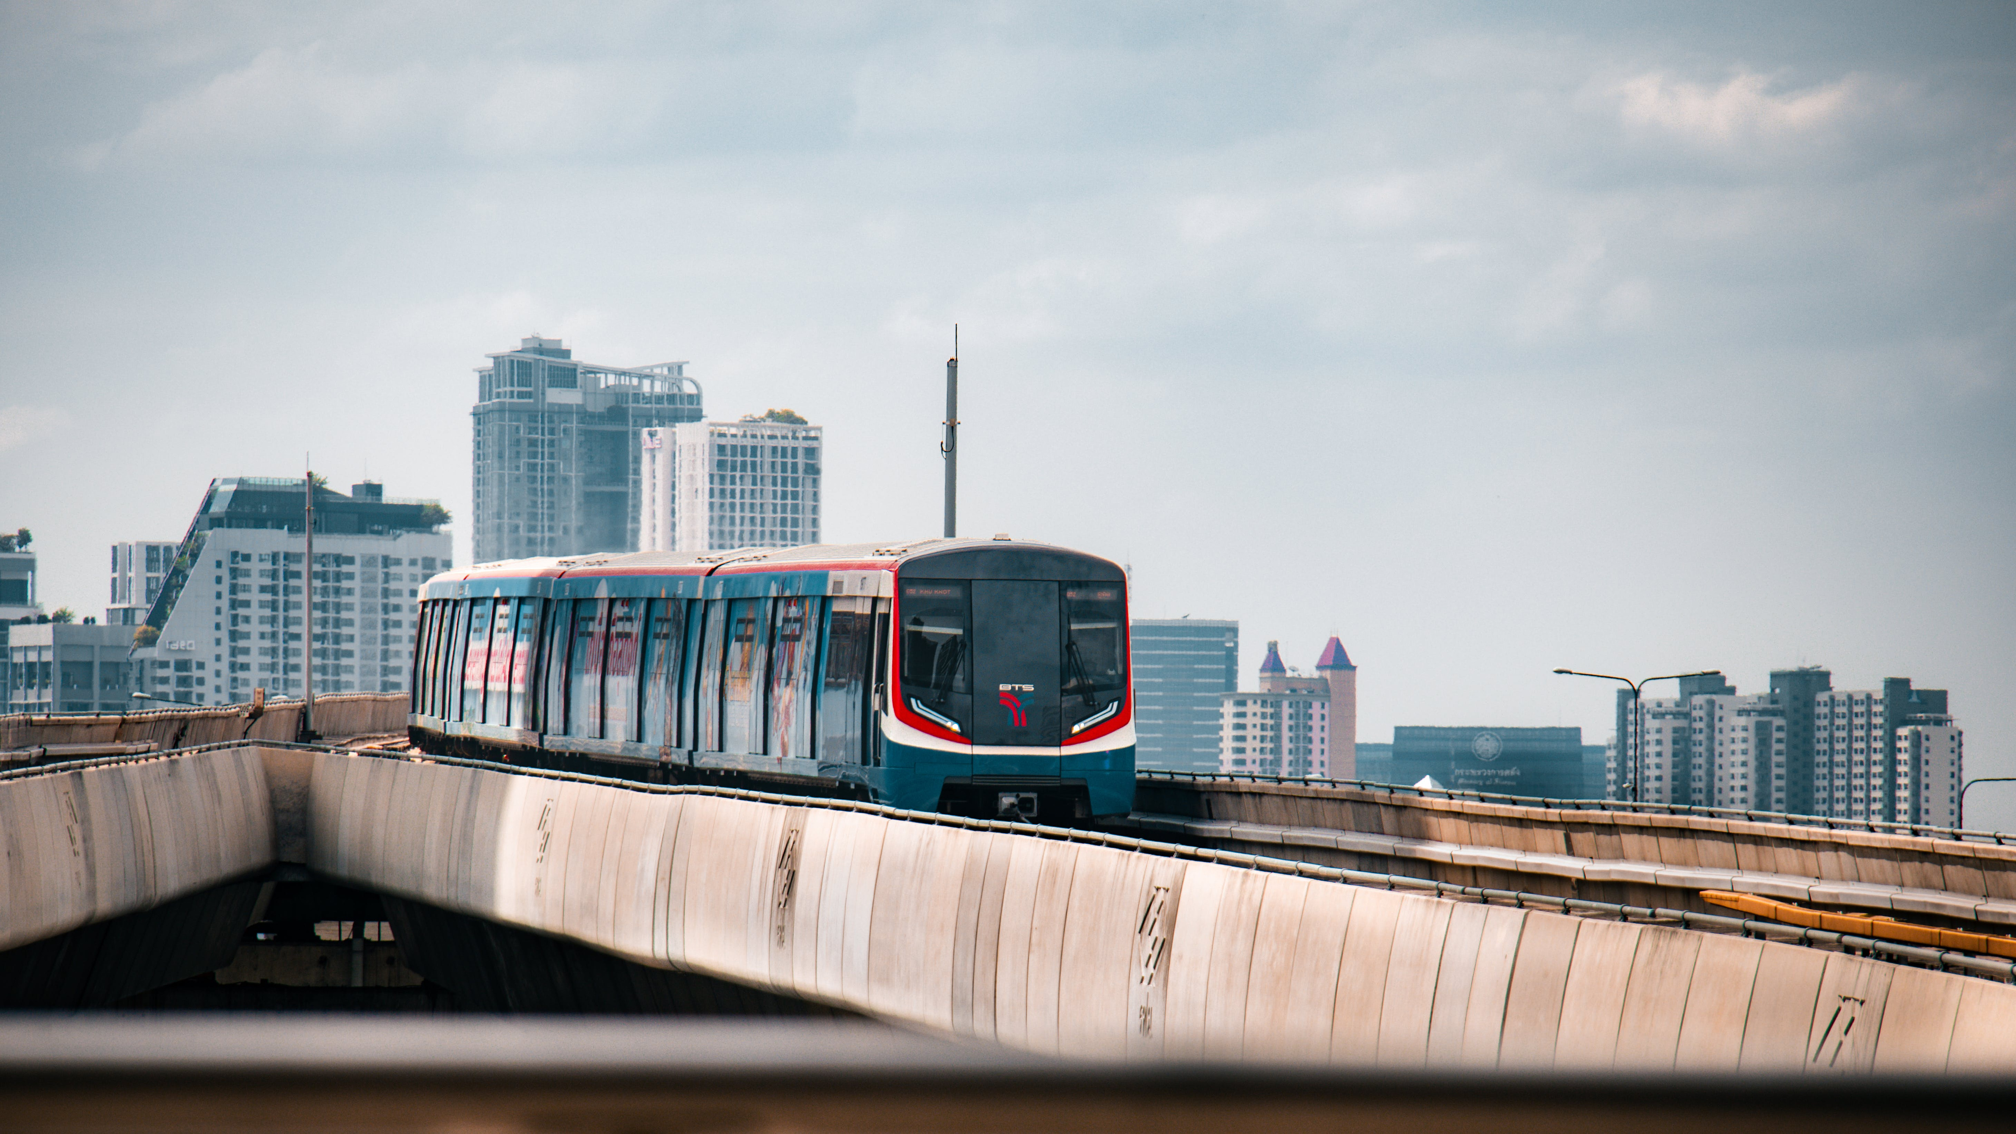

THANK YOU

